Slide 1
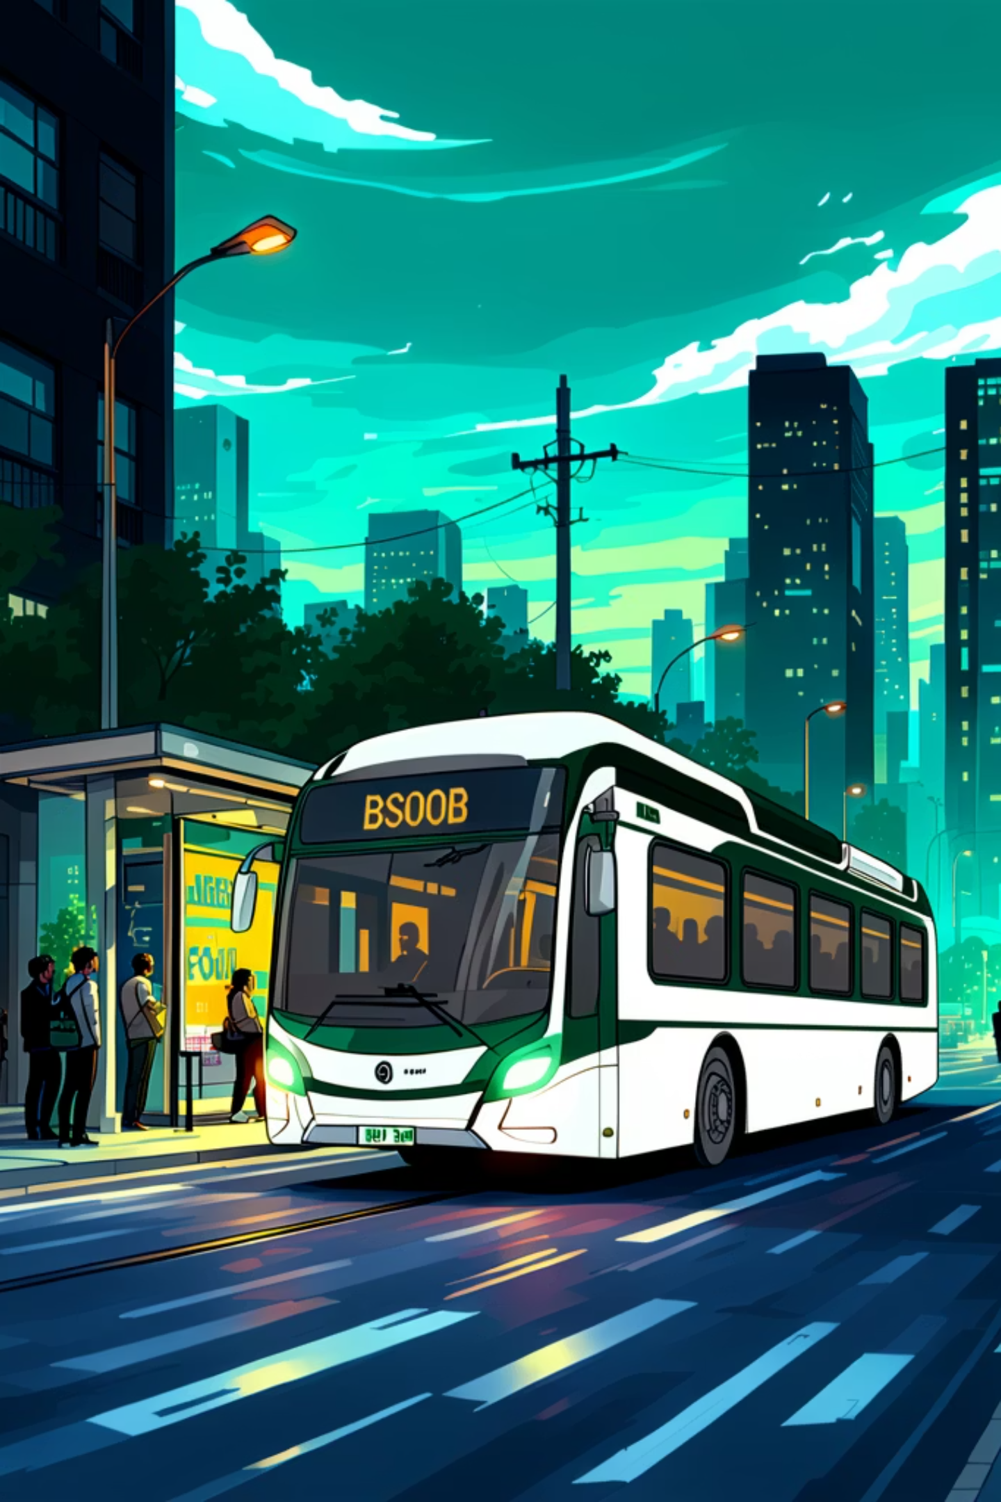
BSOOB Transit Public Hearing
Fare Policy Update
An opportunity for our community to learn about, discuss, and share feedback on proposed changes to BSOOB Transit fares.
PUBLIC HEARING
COMMUNITY INPUT WELCOME

Slide 2

Welcome — Your Voice Matters
This public hearing is your opportunity to understand the proposed fare changes, ask questions, and share your perspective directly with BSOOB Transit leadership. All community members — riders, residents, and stakeholders — are encouraged to participate.
🎤 Make a Statement
❓ Ask Questions
Share your thoughts on the proposed changes
Get answers directly from transit staff
📋 Review Materials
Access full details at bsoobtransit.org/fare-policy-update/

Slide 3
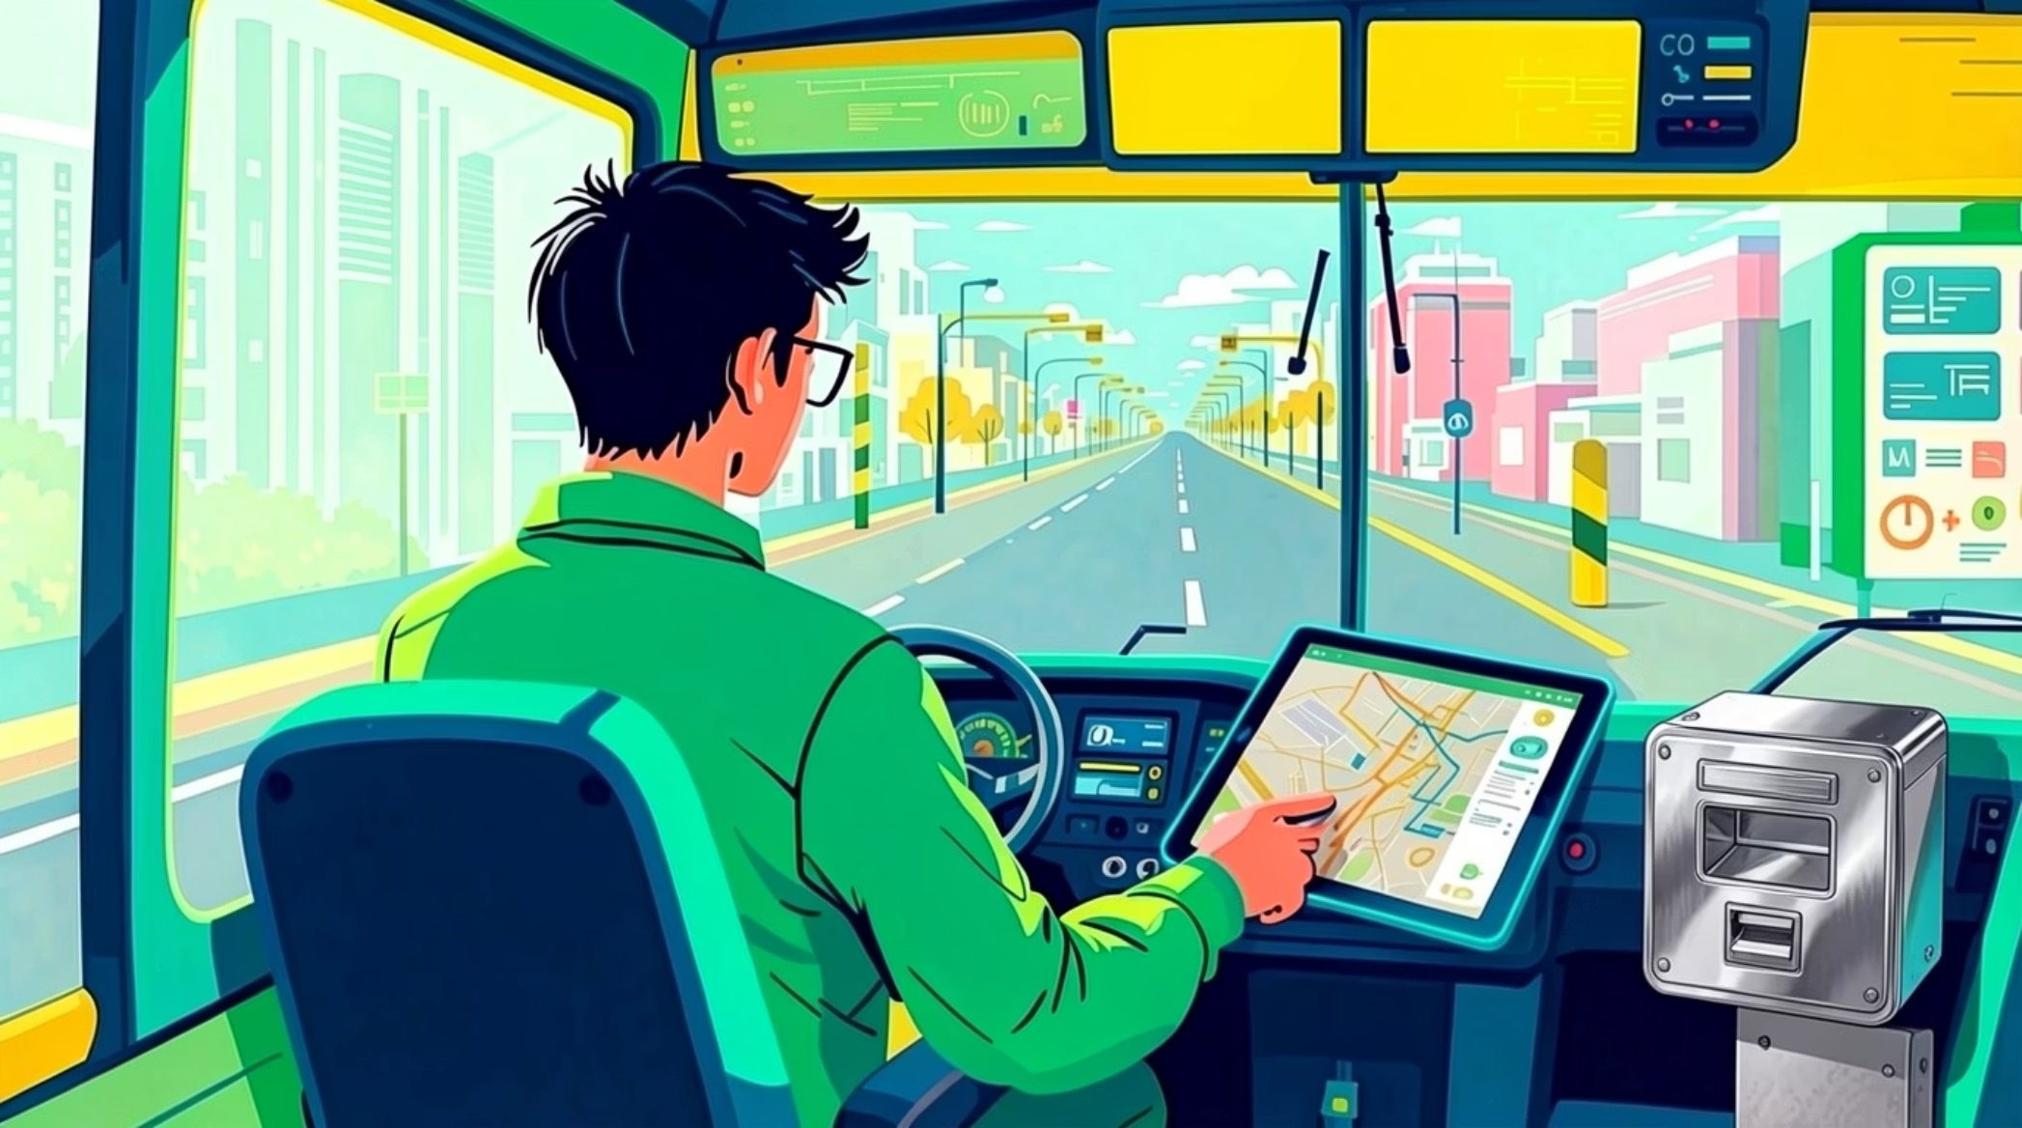
Why Are Fares Changing?
Like transit agencies across the country, BSOOB Transit faces rising operational costs — from fuel and maintenance to driver wages and vehicle replacement. These proposed fare adjustments are necessary to sustain reliable, safe, and accessible service for our community.
Rising Costs
Service Commitment
Fuel, maintenance, and labor expenses continue to grow
Maintaining frequency, coverage, and reliability for riders

Slide 4

Proposed Fare Changes at a Glance
Below is a summary of the current and proposed fare structure. Full details and supporting documentation are available at bsoobtransit.org/fare-policy-update/.
Fare Type
Current Local
Proposed Local
Current Zoom
Proposed Zoom
Adult Single Ride
$2.00
$2.25
$5.00
$4.50
Reduced Fare Single Ride
$1.00
$1.10
$2.00
$2.50
Daily Fare Cap
$6.00
$6.50
$15.00
$13.00
Reduced Fare Daily Cap
$3.00
$3.00
$7.50
$6.00
Monthly Fare Cap
$60.00
$65.00
$150.00
$130.00
Reduced Fare Monthly Cap
$30.00
$30.00
$75.00
$60.00
Reduced Fare is available to:
Persons with Disabilities, Veterans, Seniors (65+), Youth (6-18) and Medicare card holders.
Youth (6 and young) continue to ride free.

Slide 5
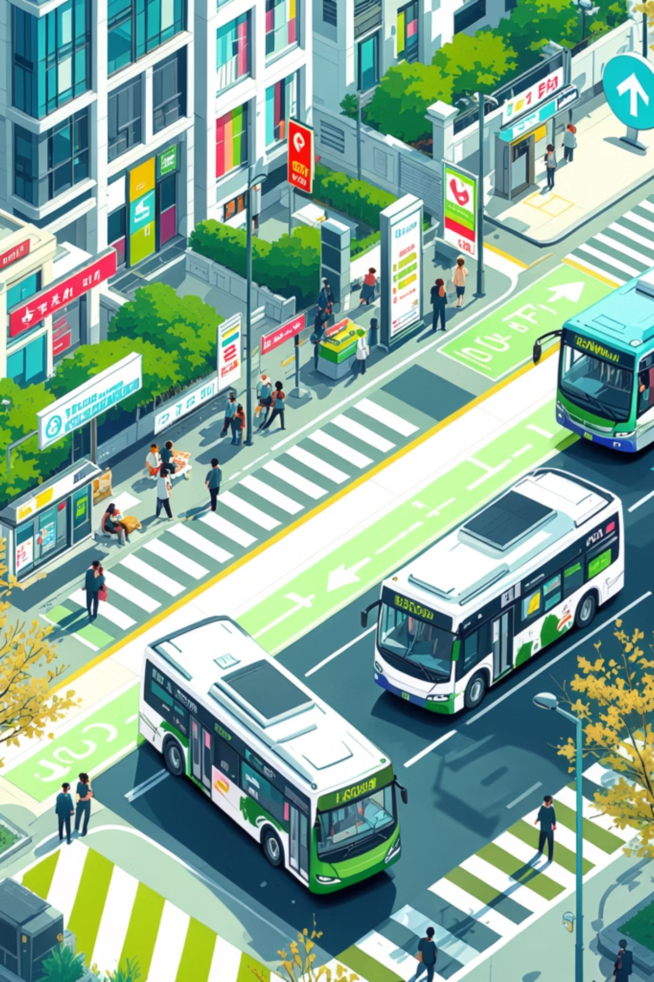
How We'll Use Your Fares
BSOOB Transit will use the revenue from the fare increase to support the service riders rely on today and strengthen the system for the future.
Retain current service levels
Maintain the frequency and coverage riders depend on.
Improve on-time performance
Ensure buses run reliably and stay on schedule.
Explore enhancements to the bus system
Make changes that increase effectiveness and better serve riders' needs.

Slide 6
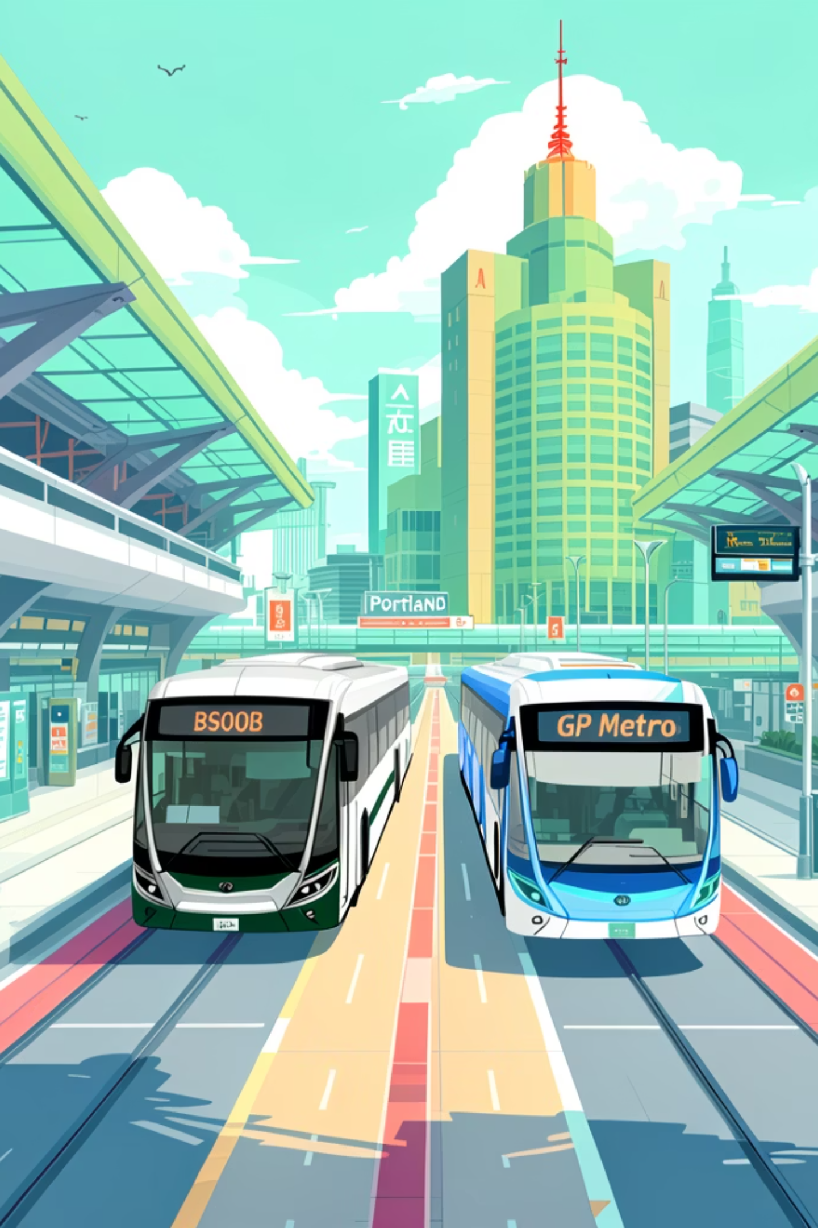



One Region, One Fare System
Through a collaborative partnership, BSOOB Transit and GP Metro jointly developed the Dirigo fare system and regional fare structure — creating a seamless network that makes travel across the region simpler and more affordable than ever before.
Unified System
One jointly developed fare policy across GP Metro and BSOOB Transit — no confusion, no extra planning
Wider Coverage
Access more destinations across the region on a single ticket
Shared Investment
Regional coordination and co-design strengthen service quality for all riders

Slide 7


Free Transfers — Ride More, Pay Less
BSOOB Transit and GP Metro partnered to develop the Dirigo fare system together, creating a regional fare structure that makes travel easier and more affordable across both networks. The jointly built system includes free transfers between agencies and fare capping features that help riders save throughout the day and month.
Free transfers and fare capping work automatically through the shared regional fare platform.
By offering free transfers and smart fare capping, you ride more for less, making daily commutes and regional travel significantly more affordable. Experience the financial freedom that comes with a streamlined, cost-effective transit solution.

Slide 8
Fare Capping: You'll Never Overpay
Fare capping ensures you always pay the lowest possible fare — automatically. Once your daily or monthly spending reaches the pass equivalent, additional rides are free.
📅 Daily Cap
🗓️ Monthly Cap
⚡ Automatic
After a set number of rides in one day, the rest are free. You never spend more than the Day Pass price.
Once your monthly spending hits the 30-Day Pass price, all remaining rides that month are free.
As long as you use your Dirigo Card. The system tracks your rides and applies the cap automatically.

Slide 9
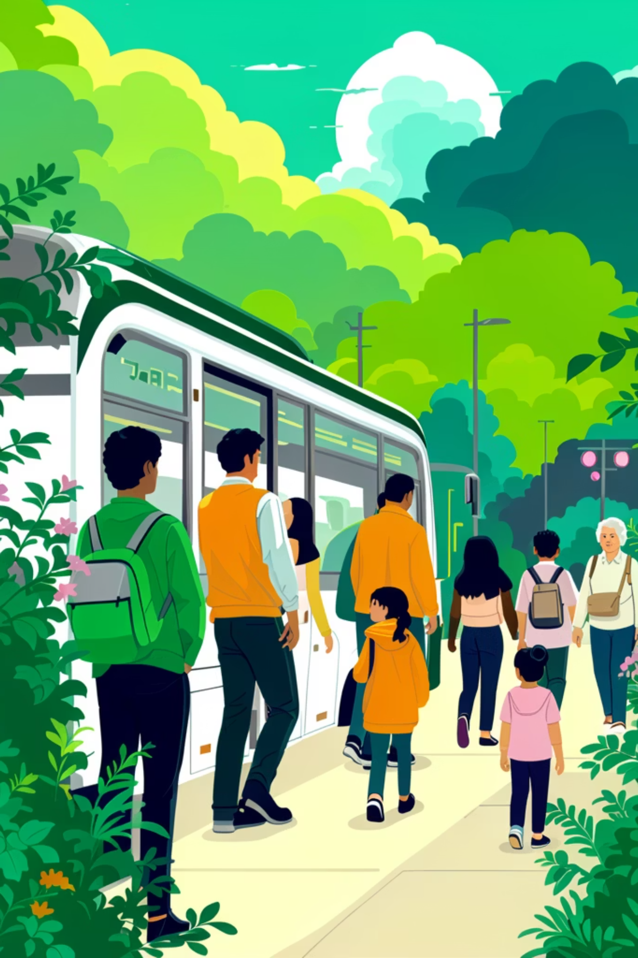
Pass Backs: Riding as a Group Just Got Easier!
GP Metro and BSOOB Transit are simplifying fare payment by eliminating the 10-ride pass and introducing pass back functionality — allowing one passenger to pay for their entire party using their Dirigo payment method.
Replaces the 10-Ride Pass
One Card, Whole Party
Pass backs duplicate the major advantage of the 10-ride pass: paying for multiple passengers in a single transaction.
A single passenger can pay for everyone in their group using their stored value — no need to purchase specific passes.
Pass backs work automatically through your Dirigo card or payment method — just tap and pay for your group.

Slide 10
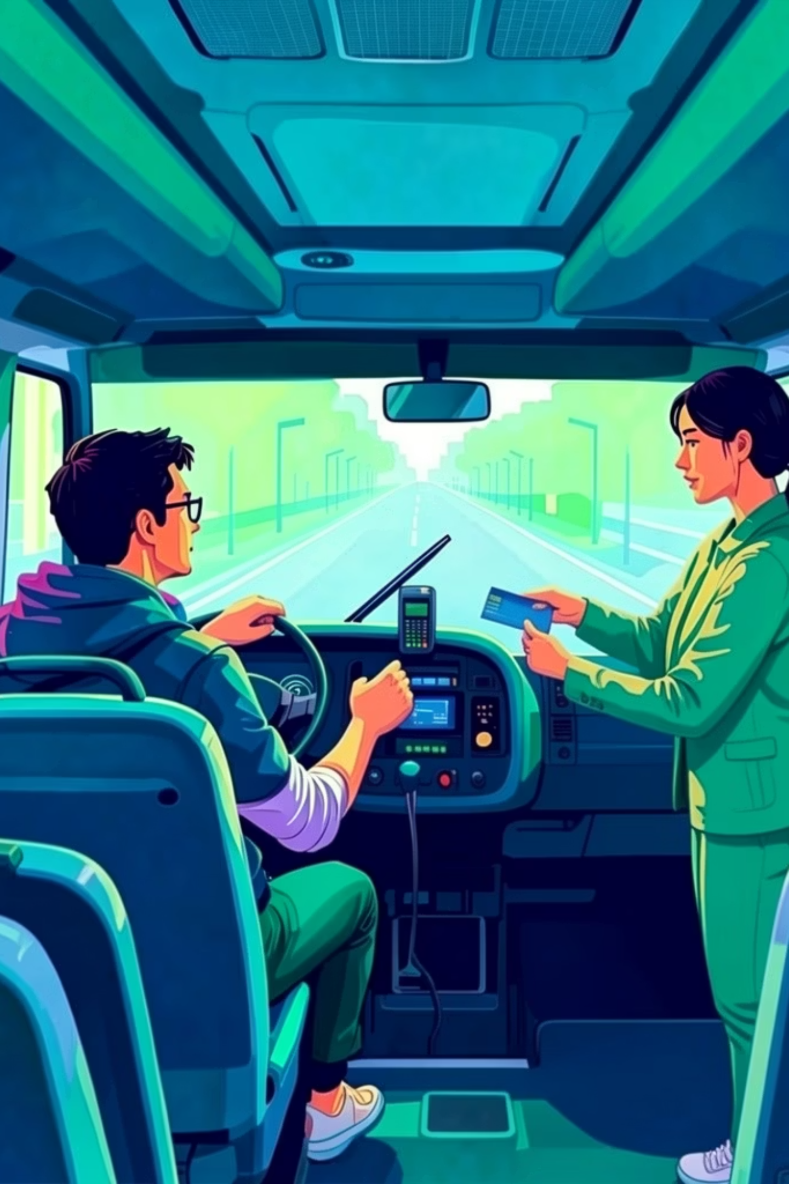
Tap to Pay Coming This Summer
Get ready for a smoother, faster ride! We're excited to announce that Tap to Pay capabilities are launching soon on the Seasonal Trolley System.
No Exact Change Needed
Tap to Pay eliminates the need to carry exact change, making boarding quick and hassle-free.
Convenient Access
Provides more convenient access to the system without needing to visit a location to get a Dirigo Card.

Slide 11


How to Participate Today
We want to hear from you. Whether you have a question, a concern, or a suggestion — this is your time to speak.
Review the Proposal
Submit Written Comments
Materials are available online at bsoobtransit.org/fare-policy-update/ and at tonight's hearing
Comments can be submitted in person or online through the public comment period
Speak at the Hearing
Stay Informed
Each speaker will have time to share their perspective
Final decisions and updates will be posted at bsoobtransit.org

Slide 12





Key Takeaways
Fares Are Being Updated
Free Regional Transfers
Modest increases are proposed to sustain quality service amid rising costs
Riders gain free transfers between BSOOB Transit and GP Metro buses
Fare Capping Protects Riders
Modern Shared Technology
Daily and monthly caps ensure you never pay more than the pass price
A unified platform brings digital payments and smarter fare management
Visit bsoobtransit.org/fare-policy-update/ for full details, or speak with a BSOOB Transit representative after the hearing.

